Slide 1



Discrete Mathematics（011122）
魏可佶 kejiwei@tongji.edu.cn

Slide 2
Chapter 1: Set Theory and Proof Methods
1.1 List of Symbols
1.2 Sets and Operations 1.3 Overview of Proof Methods 1.4 Recursive Definitions

Slide 3
1.2 Sets and Operations
Set definition and its notation
Subset and equality of sets
Empty set and universal set
Set operations (Intersection ∩, Union ∪, Relative complement −,
Symmetric difference ⊕, Absolute complement ~)
Venn diagram representation of set operations
Basic identities of set operations
Proof of partial identities
Notes:
集合定义及其表示法
集合的包含(子集)与相等
空集与全集
集合运算(交$∩$、并$∪$、相对补$−$、对称差$$、绝对补$\sim$)
集合运算的文氏表示
集合运算基本恒等式
部分恒等式证明

Slide 4
1.2 Sets and Operations
⤷Set Definition
Set Definition
Cantor and Russell's discussions:
A set is one of the most fundamental concepts in mathematics, with no rigid definition. It is understood as a collection of elements, often denoted by A, B, etc.
Element: The individual components of a set.
x ∈ A (x is an element of A)
x ∉ A (x is not an element of A)
Finite Set: A set with a limited number of elements.
Infinite Set: A set with an unlimited number of elements.
Cardinality of Set ∣A∣: The number of elements in set A.
k-element Set: A set containing k elements, where k≥0. ​
Notes:
集合定义及其表示法
集合的包含(子集)与相等
空集与全集
集合运算(交$∩$、并$∪$、相对补$−$、对称差$$、绝对补$\sim$)
集合运算的文氏表示
集合运算基本恒等式
部分恒等式证明
朴素集合论(康托, G.Cantor), 罗素(Russell)悖论
集合是数学中最基本的概念,没有严格的定义
理解成某些个体组成的整体, 常用A,B,C等表示
元素:集合中的个体
x∈A(x属于A): x是A的元素
x∉A(x不属于A): x不是A的元素
无穷集:元素个数无限的集合
有穷集(有限集):元素个数有限的集合. |A|:A中元素个数
k元集:k个元素的集合, k ≥ 0

Slide 5
1.2 Sets and Operations
⤷Set Expression
List Notation (enumeration method):
For example, A={a,b,c,d},N={0,1,2,…}
Set Builder Notation (descriptive method):
For example, {x∣P(x)}, where x is a natural number.
Explanation:
(1)The elements in the set are distinct. For example, {1,2,3}={1,1,2,3}
(2) The elements in the set do not have an order. For example {1,2,3}={3,1,2}={1,3,1,2,2}
(3) The two methods should be selected based on the context.
Common Sets:
Natural numbers N (including 0), integers Z, positive integers Z⁺ , rational numbers Q, irrational numbers Q', real numbers R, all non-zero real numbers sets R*, complex numbers C, intervals [a,b],(a,b) etc.
Notes:
列元素法（列举法） 如 A={ a, b, c, d }, N={0,1,2,…}
谓词表示法（描述法）{ x | P(x) } 如N={ x | x是自然数 }
说明:
(1) 集合中的元素各不相同. 如, {1,2,3}={1,1,2,3}
(2) 集合中的元素没有次序. 如, {1,2,3}={3,1,2}={1,3,1,2,2}
(3) 两种方法可根据需要选用.
常用集合
自然数集N（包括0）, 整数集Z, 正整数集Z⁺, 有理数集Q,
非零有理数集Q*, 实数集R, 非零实数集R*, 复数集C,
区间[a,b],(a,b)等

Slide 6
1.2 Sets and Operations
⤷Sets• Inclusion and Equality
Subset (Inclusion): A ⊆ B ⇔ ∀x (x∈A → x∈B)
Not a Subset: A ⊈ B ⇔ ∃x (x∈A ∧ x∉B)
Equality of Sets: A = B ⇔ A ⊆ B ∧ B ⊆ A
Not Equal: A ≠ B ⇔ A ⊈ B ∨ B ⊈ A
Proper Subset (Strict Subset): A ⊂ B ⇔ A ⊆ B ∧ A ≠ B
Example: A={1,2,3}, B={ x | x∈R∧|x|≤1 }, C={ x | x∈R∧x²=1 }, D={-1,1}, then we have C ⊆ B, C ⊂ B, C ⊈ A, A ⊈ B, B ⊈ A, C = D
Properties:
(1) A ⊆ A
(2) A ⊆ B ∧ B ⊆ C → A ⊆ C
Notes:
不真包含 A ⊄ B
意味着A⊆B 但不是 A⊂B，即A可以是B的一个完全相等的集合。
等价（Equivalence）通常使用符号 “↔” 或 “⇔” 表示；
蕴含（Implication）通常使用符号 "→" 或 "⇒" 表示
包含(子集) A ⊆ B ⇔ ∀x (x∈A → x∈B)
不包含 A ⊈ B ⇔ ∃x (x∈A ∧ x∉B)
相等 A = B ⇔ A ⊆ B ∧ B ⊆ A
不相等 A ≠ B ⇔ A ⊈ B ∨ B ⊈ A
真包含(真子集) A ⊂ B ⇔ A ⊆ B ∧ A ≠ B
例如, A={1,2,3}, B={ x | x∈R∧|x|≤1 }, C={ x | x∈R∧x²=1 },
D={-1,1}, 则有C ⊆ B, C ⊂ B, C ⊈ A, A ⊈ B, B ⊈ A, C = D
性质 (1) A ⊆ A
(2) A ⊆ B ∧ B ⊆ C → A ⊆ C

Slide 7
1.2 Set and its operations ⤷Sets •Empty Set and Universal Set
Empty set ∅: A set that contains no elements.
Example: {x | x²<0∧x∈R}=∅
Theorem 1.1: The empty set is a subset of any set.
Proof: By contradiction.
Suppose the contrary, i.e., there exists a set A, such that ∅ ⊈ A, This means there exists an element x, x∈∅ and x∉A, which is a contradiction.
Corollary: The empty set is unique.
Proof: Suppose there exist two empty sets ∅₁ ∅₂, then ∅₁⊆∅₂ and ∅₂⊆∅₁, Hence ∅₁=∅₂
Universal set E: A set E is called the universal set if all sets discussed in a problem is subset of E , then ∀A (A⊆E ), then E is referred to as the universal set.
Notes:
定理1.1 空集是任何集合的子集 证 用归谬法. 假设不然, 则存在集合A, 使得 ⊈ A, 即存在x, x且xA, 矛盾 英文
推论 空集是惟一的.
证 假设存在∅₁和∅₂，则∅₁⊆∅₂ 且∅₂⊆∅₁，因此∅₁=∅₂
全集E:限定问题所讨论的集合都是E的子集，即∀A (A⊆E )，则称E为全集.
则称E为全集. 如整数问题中的Z

Slide 8
1.2 Set and its operations
⤷Sets• Power Set and Universal Set
(Power Set) It refers to the set of all subsets of a given set, including the empty set and the set itself，express as P(A) or 2^{A}
Definition P(A) = { x | x⊆A }
Example:
P(∅) = {∅}，
P({∅}) = {∅,{∅}}
P({1,{2,3}})={∅,{1},{{2,3}},{1,{2,3}}}
Count
If |A| = n，then |P(A)| = 2^{n}
Notes:
幂集 (Power Set) 是指某个集合的所有子集组成的集合，包括空集和集合本身，可表示为 P(A) 或 2^{A}
定义 P(A) = { x | x⊆A }
实例
P(∅) = {∅}，
P({∅}) = {∅,{∅}}
P({1,{2,3}})={∅,{1},{{2,3}},{1,{2,3}}}
计数
如果 |A| = n，则 |P(A)| = 2^{n}
全集E:限定问题所讨论的集合都是E的子集，即∀A (A⊆E )，则称E为全集. 如整数问题中的Z

Slide 9
1.2 Sets and operations
⤷ Sets Operations• (∪ ,∩, −, ⊕, ~)
Union: A ∪ B = { x | x∈A ∨ x∈B }
Intersection: A ∩ B = { x | x∈A ∧ x∈B }
Relative Complement: A − B = { x | x∈A ∧ x∉B }
Symmetric Difference:
A ⊕ B = (A−B) ∪ (B−A) = (A ∪ B) −(A ∩ B)
Absolute Complement: ~ A = E − A= { x | x∉A }
Instructions:
(1)Use only parentheses.
(2)Order of Operations:
Priority (1):Parentheses
Priority (2): Complement ∼\sim∼ and power set
Priority (3): Other operations.
Operations of the same priority are evaluated from left to right.
Example1：
Design E={0,1, … ,9}, A={0,1,2,3}, B={1,3,5,7,9},
Then： A ∪ B ={0,1,2,3,5,7,9}, A ∩ B ={1,3}, A − B ={0,2},
A ⊕ B ={0,2,5,7,9}, ~ A ={4,5,6,7,8,9}, ~ B ={0,2,4,6,8}
Notes:
并 A∪B = { x | x∈A ∨ x∈B }
交 A∩B = { x | x∈A ∧ x∈B }
相对补 A−B = { x | x∈A ∧ x∉B }
对称差 A⊕B = (A−B)∪(B−A) = (A∪B)−(A∩B)
绝对补 ∼A = E−A= { x | x∉A }
例： 设E={0,1, … ,9}, A={0,1,2,3}, B={1,3,5,7,9},
则有：
A∪B ={0,1,2,3,5,7,9}, A∩B ={1,3}, A−B ={0,2},
A⊕B ={0,2,5,7,9}, ∼A ={4,5,6,7,8,9},
∼B ={0,2,4,6,8}
说明:1. 只使用圆括号
2. 运算顺序: 优先级别为(1)括号, (2)∼和幂集, (3)其他.同级别的按从左到右运算。

Slide 10
1.2 Sets and its operations
⤷Sets operations • Set and its operations
Example 1: Let E={ x | x is a student at a university in Beijing}, A,B,C,D are subsets from E,
A= { x | x is from Beijing}}, B= { x | x is a external student},
C= { x | x is a student in the Department of Mathematics
D= { x | x likes listening to music}.
Describe the characteristics of the following sets of students:
(A∪D) ∩ ~C=
{ x | x is from Beijing or likes listening to music, but is not a mathematics student}
~ A ∩ B=
{ x | x is a non-local commuting student}
(A − B) ∩ D=
{ x | x is a boarding student in Beijing and likes listening to music}
~ D ∩ ~B=
{ x | x is a boarding student who does not like listening to music}
Notes:
例1 设E={ x | x是北京某大学学生}, A,B,C,D是E的子集,
A= { x | x是北京人}, B= { x | x是走读生},
C= { x | x是数学系学生}, D= { x | x是喜欢听音乐的学生}.
试描述下列各集合中学生的特征:
{ x | x是北京人或喜欢听音乐,
但不是数学系学生}
{ x | x是外地走读生}
{ x | x是北京住校生, 并且喜欢听音乐}
{ x | x是不喜欢听音乐的住校生}

Slide 11
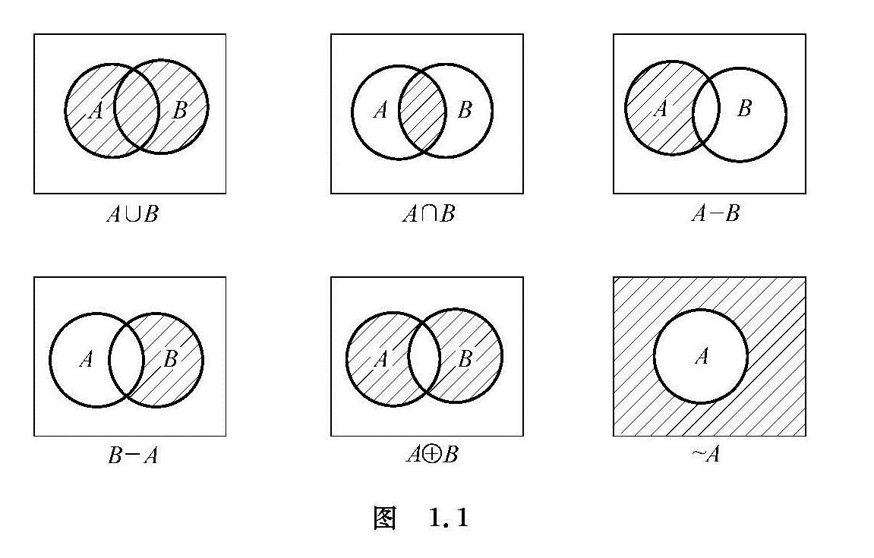
1.2 Set Operations
⤷ Set Operations • Venn Diagram Representation

Slide 12
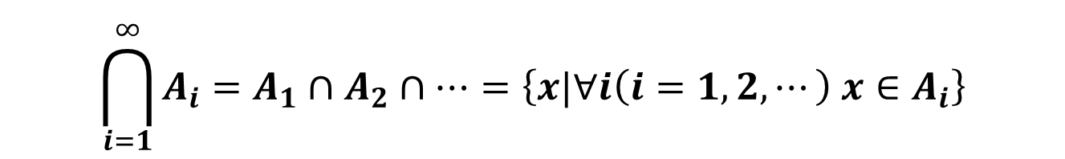
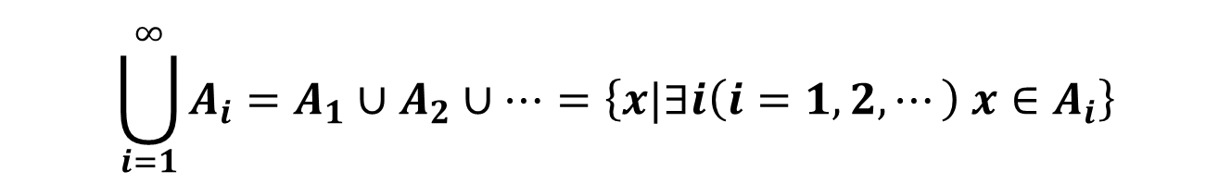
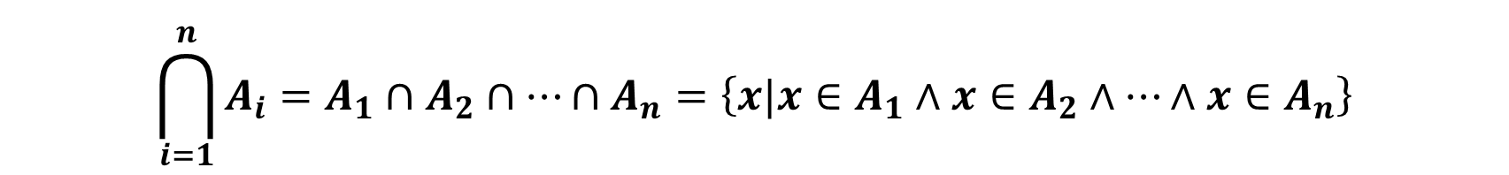

1.2 Set Operations
⤷ Set Operations • Extended
Union and intersection operations can be extended to a finite number of sets
$$\bigcup_{i=1}^{n}{A_{i}}=A_{1}∪A_{2}∪⋯∪A_{n}=\left\{x|x∈A_{1}∨x∈A_{2}∨⋯∨x∈A_{n}\right\}$$
$$\bigcap_{i=1}^{n}{A_{i}}=A_{1}∩A_{2}∩⋯∩A_{n}=\left\{x|x∈A_{1}∧x∈A_{2}∧⋯∧x∈A_{n}\right\}$$
Union and intersection operations can also be extended to countably infinite sets.
$$\bigcup_{i=1}^{∞}{A_{i}}=A_{1}∪A_{2}∪⋯=\left\{x|∃i\left(i=1,2,⋯\right) x∈A_{i}\right\}$$
$$\bigcap_{i=1}^{∞}{A_{i}}=A_{1}∩A_{2}∩⋯=\left\{x|∀i\left(i=1,2,⋯\right) x∈A_{i}\right\}$$
Notes:
并和交运算可以推广到有穷个集合上
A₁∪A₂∪…∪A_{n}= {x | x∈A₁∨x∈A₂∨…∨x∈A_{n}}
A₁∩A₂∩…∩A_{n}= {x | x∈A₁∧x∈A₂∧…∧x∈A_{n}}
并和交运算还可以推广到可数无穷个集合上
A₁∪A₂∪…= { x | ∃i (i=1,2,…) x∈A_{i} }
A₁∩A₂∩…= { x | ∀i (i=1,2,…) x∈A_{i} }

Slide 13
1.2 Set Operations
⤷ Set Operations • extended
Example2： Let A_{i}=[0, 1/i ), B_{i}=(0, i ), i=1,2, …, then
[0, 1)
[0, 1)
[0, 1/n )
{ 0 }
(0, n)
(0, +∞)
(0, 1)
(0, 1)

Slide 14
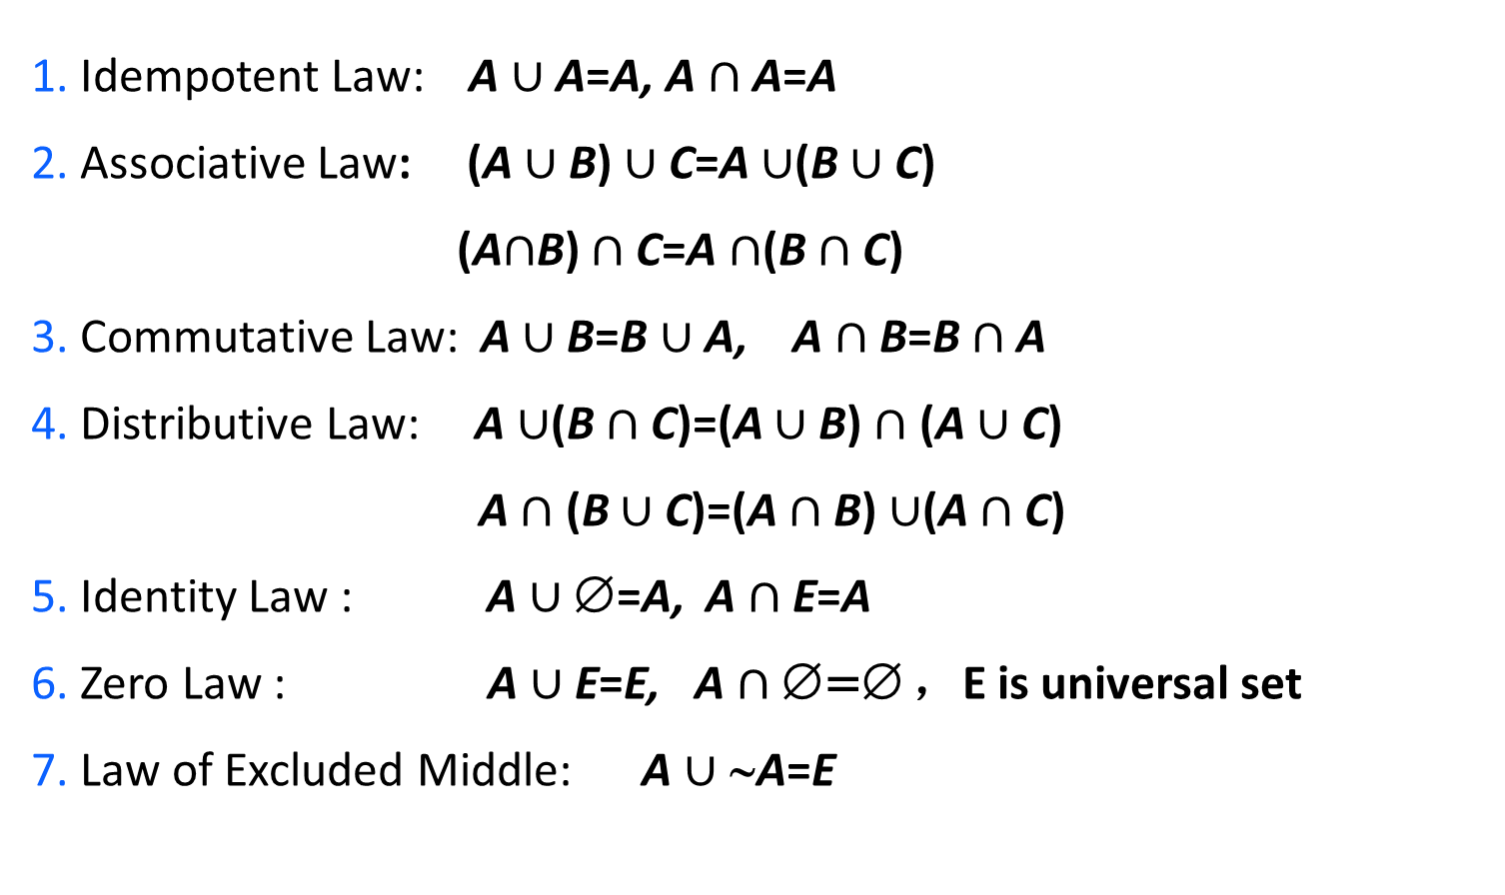
1.2 Set Operations
⤷ Set Operations • Identical equation（law）
1. Idempotent Law: A $∪$ A=A, A $∩$A=A
2. Associative Law: (A $∪$B) $∪$C=A $∪$(B $∪$C)
(A$∩$B) $∩$C=A $∩$(B $∩$C)
3. Commutative Law: A $∪$B=B $∪$A, A $∩$B=B $∩$A
4. Distributive Law: A $∪$(B $∩$C)=(A $∪$B) $∩$ (A $∪$C)
A $∩$ (B $∪$C)=(A $∩$B) $∪$(A $∩$C)
5. Identity Law : A $∪$∅=A, A $∩$E=A
6. Zero Law : A $∪$E=E, A $∩$∅=∅ ，E is universal set
7. Law of Excluded Middle: A $∪$∼A=E
Notes:
恒等律指的是在某些集合运算中，存在特定的集合（如全集和空集），使得运算的结果与另一个参与运算的集合恒等。
身份律是指在集合运算中，某些特定的集合（如空集或全集）在运算中起到了“不改变其他集合”的作用。
排中律（Law of Excluded Middle）指的是对于任何一个元素，它要么属于某个集合，要么属于这个集合的补集，不存在第三种可能。
1. 幂等律 A∪A=A, A∩A=A
2. 结合律 (A∪B)∪C=A∪(B∪C)
(A∩B)∩C=A∩(B∩C)
3. 交换律 A∪B=B∪A, A∩B=B∩A
4. 分配律 A∪(B∩C)=(A∪B)∩(A∪C)
A∩(B∪C)=(A∩B)∪(A∩C)
5. 同一律（恒等律、身份律） A∪∅=A, A∩E=A
6. 零 律 A∪E=E, A∩∅=∅ ，E是全集
7. 排中律 A∪∼A=E

Slide 15
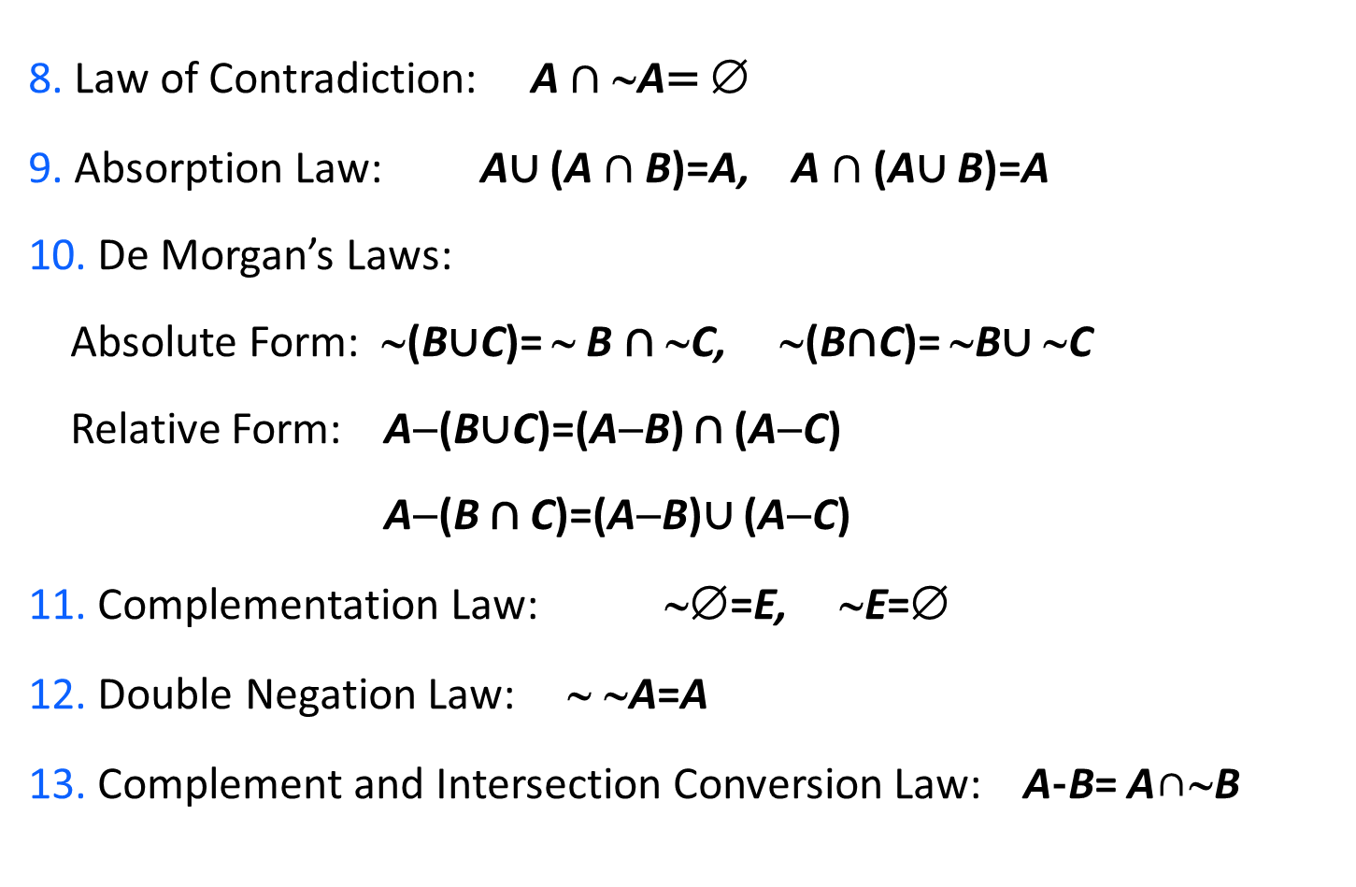
1.2 Set Operations
⤷ Set Operations • Identical equation（law）
8. Law of Contradiction: A $∩$∼A= ∅
9. Absorption Law: A∪ (A $∩$B)=A, A $∩$ (A∪ B)=A
10. De Morgan’s Laws:
Absolute Form: ∼(B∪C)= ∼ B ∩ ∼C, ∼(B∩C)= ∼B∪ ∼C
Relative Form: A−(B∪C)=(A−B) ∩ (A−C)
A−(B ∩ C)=(A−B)∪ (A−C)
11. Complementation Law: ∼∅=E, ∼E=∅
12. Double Negation Law: ∼ ∼A=A
13. Complement and Intersection Conversion Law: A-B= A∩∼B
Notes:
14. 对称差的恒等式
(1) 交换律 AB=BA
(2) 结合律 (AB)C=A(BC)
(3) 对的分配律 A(BC)=(AB)(AC)
(4) A=A, AE= ~ A
(5) AA=, A ~ A= E

Slide 16
1.2 Set Operations
⤷ Set Operations • Identical equation（law）
14. Identities of Symmetric Difference
(1) Commutative Law: A⊕B=B⊕A
(2) Associative Law : (A⊕B)⊕C=A⊕(B⊕C)
(3) Distributive Law of Intersection over Symmetric Difference:
A ∩ (B⊕C)=(A ∩ B)⊕(A ∩ C)
(4) A⊕∅=A, A⊕E= ~A
(5) A⊕A=∅, A⊕ ~A= E
Note: The union operation ∪ does not distribute over the symmetric difference⊕, A counter example is given below:
A={a,b,c}, B={b,c,d}, C={c,d,e}
A ∪ (B ⊕ C)= {a,b,c} ∪ {b,e}= {a,b,c,e}
(A ∪ B) ⊕ (A∪C)= {a,b,c,d} ⊕ {a,b,c,d,e}= {e}, not equal
Notes:
集合A与空集的对称差（也称为对称差分）定义为集合A中的元素和空集中的元素的并集，但不包括A和空集中共有的元素。由于空集不包含任何元素，因此对称差将只包含集合A中的所有元素。
Distributive Law of Intersection over Symmetric Difference
14. Identities of Symmetric Difference
(1) Commutative Law A⊕B=B⊕A
(2) Associative Law (A⊕B)⊕C=A⊕(B⊕C)
(3) ∩对⊕的分配律 A∩(B⊕C)=(A∩B)⊕(A∩C)
(4) A⊕∅=A, A⊕E= ~ A
(5) A⊕A=∅, A⊕ ~ A= E
注意: ∪对⊕没有分配律, 反例如下
A={a,b,c}, B={b,c,d}, C={c,d,e}
A∪(B⊕C)= {a,b,c}∪{b,e}= {a,b,c,e}
(A∪B)⊕(A∪C)= {a,b,c,d}⊕{a,b,c,d,e}= {e}, 两者不等

Slide 17
1.2 Set Operations
⤷ Set Operations • Identical equation（law）
15. A⊆A ∪ B, B⊆A ∪ B.
16. A ∩ B⊆A, A ∩ B⊆B.
17. A-B⊆A.
18. A ∪ B=B⇔A⊆B⇔A ∩ B=A⇔A-B=∅.
A⊕B=A⊕C ⇔ B=C.

Slide 18
1.2 Set Operations
⤷ Set Operations • Proof of Identity
Method
(1) Prove based on the definition.
(2) Use known set equalities or inclusions and prove through set algebra
Example 3 proof:
(1) A ∪ B=B ∪ A (Commutative Law of Union)
Proof：We need to prove that both A∪B⊆B∪A and B∪A⊆A∪B hold
∀x x∈A ∪ B
⇒ x∈A or x∈B, Then x∈B or x∈A
⇒ x∈B ∪ A
Thus, we have proven that A ∪ B⊆B ∪ A.
Similarly, we can prove that B ∪ A⊆A ∪ B.
Notes:
方法一. 根据定义证明
方法二. 利用已知集合等式或包含式, 通过集合演算证明
例3 证明:
(1) A∪B=B∪A (并集交换律)
证：需要证明A∪B⊆B∪A 和 B∪A⊆A∪B成立
∀x x∈A∪B
⇒ x∈A 或 x∈B, 自然有 x∈B 或 x∈A
⇒ x∈B∪A
得证 A∪B⊆B∪A.
同理可证 B∪A⊆A∪B.

Slide 19
1.2 Set Operations
⤷ Set Operations • Proof of Identity
(2) A ∪ (B∩C)=(A ∪ B)∩(A ∪ C) (Distributive Law of Union over Intersection)
Proof：We need to proof A∪(B ∩ C)⊆(A∪B) ∩ (A∪C) and (A∪B)∩(A∪C)⊆A∪(B ∩ C)
∀x x∈A∪(B ∩ C)
⇒ x∈A or (x∈B and x∈C)
⇒(x∈A or x∈B) and (x∈A or x∈C)
⇒x∈(A∪ B) ∩ (A∪C)
Therefore A∪(B ∩ C) = (A∪B) ∩ (A∪C).
which proves (A∪B) ∩ (A∪C) ⊆ A ∪ (B ∩ C).
(3) A∪E=E (Union with the Universal Set)
Proof：According to the definition of union, we have E ⊆ A∪E.
According to the definition of the universal set, we have A∪E ⊆ E
Notes:
(2) A∩(B∩C)=(A∪B)∩(A∪C) (并集对交集分配律)
证：需证A∪(B∩C)⊆(A∪B)∩(A∪C)和(A∪B)∩(A∪C)⊆A∪(B∩C)
∀x x∈A∪(B∩C)
⇒ x∈A或(x∈B且 x∈C)
⇒(x∈A或x∈B)且(x∈A或x∈C)
⇒x∈(A∪B)∩(A∪C)
得证 A∪(B∩C)⊆(A∪B)∩(A∪C).
类似可证 (A∪B)∩(A∪C)⊆A∪(B∩C).
(3) A∪E=E (并集的零律)
证 根据并的定义, 有E⊆A∪E.
根据全集的定义, 又有A∪ E⊆E

Slide 20
1.2 Set Operations
⤷ Set Operations • Proof of Identity
(4) A∩E=A (Law of Identity)
Proof：We need to prove A⊆A∩E and A ∩ E⊆A
By the definition of intersection, we have A ∩ E⊆A.
For ∀x x∈A,
By the definition of the universal set E
x∈E, Therefore x∈A and x∈E,
⇒ x∈A ∩ E
Thus A⊆A ∩ E.
Notes:
要证明 A∩E=A，我们需要证明两个集合的每个元素都是相同的
(4) A∩E=A (同一律)
证：需证明 A⊆A∩E 和A∩E⊆A
根据交的定义, 有A∩E⊆A.
又, ∀x x∈A,
根据全集E的定义,
x∈E, 从而 x∈A且x∈E,
⇒ x∈A∩E
得证 A⊆A∩E.

Slide 21
1.2 Set Operations
⤷ Set Operations • Proof of Identity
Example 4： Prove that A ∪ (A∩B)=A （Absorption Law）
Proof: Using the four identities proven in Example 3 to prove:
A ∪ (A ∩ B)
= (A ∩ E) ∪ (A ∩ B) (Law of Identity)
= A ∩ (E ∪ B) (Distributive Law)
= A ∩ (B ∪ E) (Commutative Law)
= A ∩ E (Law of Excluded Null)
= A (Law of Identity)
For the remaining basic set identities, we will not prove each one individually (please prove them yourself). From now on, we will use them as known set identities.
Notes:
A∪(A∩B)
= (A∩E)∪(A∩B) (同一律)
= A∩(E∪B) (分配律)
= A∩(B∪E) (交换律)
= A∩E (零律)
= A (同一律)
对其余的基本集合恒等式不再一一证明(请自行证明),
今后把它们作为已知的集合等式使用.

Slide 22
1.2 Set Operations
⤷ Set Operations • Proof of Identity
Example 5： Prove that (A – B) – C=(A – C) – (B – C)
Proof:
(A – C) – (B – C)
= (A ∩ ~C) ∩ ~(B ∩ ~ C) (Complement Intersection Conversion)
= (A ∩ ~C) ∩ (~B ∪ ~~C) (De Morgan’s Law))
= (A ∩ ~C) ∩ (~B ∪ C) (Double Negation Law)
= (A ∩ ~C ∩ ~B) ∪ (A ∩ ~C ∩ C) (Distributive Law)
= (A ∩ ~C ∩ ~B) ∪ (A ∩ ∅) (Contradiction Law)
= A ∩ ~C ∩ ~B (Zero Law, Identity Law)
= (A ∩ ~B) ∩ ~C (Commutative Law, Associative Law)
= (A – B) – C (Complement Intersection Conversion Law)
Notes:
13. Complement and Intersection Conversion Law: A-B= A∩∼B

Slide 23
1.2 Set Operations
⤷ Set Operations • Proof of Identity
Example 6： Prove (A ∪ B )⊕(A ∪ C)= (B ⊕C ) - A
Need to prove (A ∪ B )⊕(A ∪ C)
=((A ∪ B) - (A ∪ C )) ∪ ((A ∪ C) - (A ∪ B))
=((A ∪ B) ∩ ~A ∩ ~C ) ∪ ((A ∪ C ) ∩ ~A ∩ ~B)
= (B ∩ ~A ∩ ~C) ∪ (C ∩ ~A ∩ ~B)
=((B ∩ ~C) ∪ (C ∩ ~B)) ∩ ~A
=((B-C) ∪ (C-B )) ∩ ~A
= (B ⊕C) - A

Slide 24
1.2 Set Operations
⤷ Set Operations • Proof of Identity
Example 7： Let A and B be any sets, with power sets P(A) and P(B).
Prove that: If A⊆B, then P(A)⊆P(B)
Proof ：∀x x∈P(A) ⇔ x⊆A
⇒ x⊆B (Since A⊆B)
⇔ x∈P(B)
Notes:
例7 设A,B为任意集合, 幂集分别为P(A)、P(B)，证明:
若A⊆B, 则P(A)⊆P(B)
证 ∀x x∈P(A) ⇔ x⊆A
⇒ x⊆B (已知A⊆B)
⇔ x∈P(B)

Slide 25
1.2 Set Operations
⤷ Set Operations • Proof of Identity
Example8： Proof A⊕B=A ∪ B-A ∩ B.
Proof A⊕B=(A ∩ ~B) ∪ (~A ∩ B)
=(A ∪ ~A) ∩ (A ∪ B) ∩ (~B ∪ ~A) ∩ (~B ∪ B)
=(A ∪ B) ∩ (~B ∪ ~A)
=(A ∪ B) ∩ ~(A ∩ B)
=A ∪ B-A ∩ B

Slide 26
1.3 Proof Methods
Direct Proof Method
Indirect Proof Method
Reductio ad Absurdum (Proof by Contradiction)
Exhaustive Method
Constructive Proof Method
Vacuous Proof Method
Trivial Proof Method
Mathematical Induction
Counterexample—Proof that a Proposition is False
Notes:
• 直接证明法 • 间接证明法
归谬法(反证法) • 穷举法
构造证明法 • 空证明法
平凡证明法 • 数学归纳法
• 举反例—命题为假的证明

Slide 27
1.3 Proof Methods
⤷Propositional Forms
Form 1: If A, then B
Form 2: A if and only if B
Form 3: Prove B
All can be reduced to Form 1
Notes:
形式1. 若A, 则B A→B
形式2. A当且仅当B A↔B
形式3. 证明B B
都可归结为形式1

Slide 28
1.3 Proof Methods
⤷Direct Proof Method
Method: Assume A is true, prove B is true.
Example 1: If n is odd, then n² is also odd. Proof:
Assume n is odd, then there exists k ∈ N,
such that n = 2k + 1.
Therefore, n² = (2k + 1)² = 2(2k² + 2k) + 1 Thus, n² is odd.
Notes:
做法 假设A为真, 证明B为真.
例1 若n是奇数, 则n²也是奇数.
证 假设n是奇数, 则存在k∈N, n=2k+1. 于是,
n² = (2k+1)²
= 2(2k²+2k)+1
得证n²是奇数.

Slide 29
1.3 Proof Methods
⤷Indirect Proof Method • Proof by Contrapositive
Indirect proof method is a generalized proof technique that encompasses any method of proof that does not directly derive the conclusion from the premise.
Logical fact：A proposition and its contrapositive are logically equivalent.
Method: To prove "A → B", it is sufficient to prove "¬B → ¬A", that is, "If B is not true, then A is not true."
Example 2: If n² is odd, then n is also odd. Proof: It suffices to prove that: If n is even, then n² is even. That is, prove the original proposition is true. Assume n is even, then there exists k ∈ N, such that n = 2k. Therefore, n² = (2k)² = 2(2k²) Thus, n² is even.
Notes:
间接证明法是一种广义的证明方法，涵盖了任何不直接从假设推出结论的证明方式。
事实：命题和它的逆否定命题在逻辑上是等价
做法：要证明“A → B” ， 只需证明“¬ B→ ¬ A” ，即
“若B不成立, 则A不成立。
例2 若n²是奇数, 则n也是奇数.
证：只要证得:若n是偶数, 则n²也是偶数.即证得原命题为真。
假设n是偶数, 则存在k∈N, n=2k. 于是,
n² = (2k)²
= 2(2k²)
得证n²是偶数.

Slide 30
1.3 Proof Methods
⤷Indirect Proof Method • Proof by Contradiction
Proof by Contradiction begins by assuming that the negation of the proposition to be proven is true, and then through logical reasoning, a contradiction or an impossible result is derived.
Method: Let A be true, assume B is not true, and derive a contradiction.
Example 3: If A−B=A, then A∩B=∅. Proof: Using proof by contradiction, assume A∩B≠∅. Then there exists an element x such that x∈A∩B ⟺ x∈A and x∈B. Since A−B=A, it follows that x∈A−B and x∈B ⟺ (x∈A and x∉B) and x∈B ⟹ x∉B and x∈B, which is a contradiction.
Notes:
归谬法（反证法）：归谬法是
归谬法和反证法通常在数学和逻辑中被视为相同的证明方法，都是间接证明法的一种特例。间接证明法的一种特殊形式。在归谬法中，首先假设要证明的命题的否定是真的，然后通过逻辑推理导出一个矛盾或不可能的结果。
归谬法首先假设要证明的命题的否定是真的，然后通过逻辑推理导出一个矛盾或不可能的结果。
做法 设A成立, 假设B不成立, 推出矛盾.
例3 若A-B=A, 则A∩B=∅
证 用归谬法, 假设A∩B≠∅, 则存在x,使得
x∈A∩B ⇔ x∈A且x∈B
⇒ x∈A-B且x∈B (A-B=A)
⇔ (x∈A且x∉B)且x∈B
⇒ x∉B且x∈B, 矛盾

Slide 31
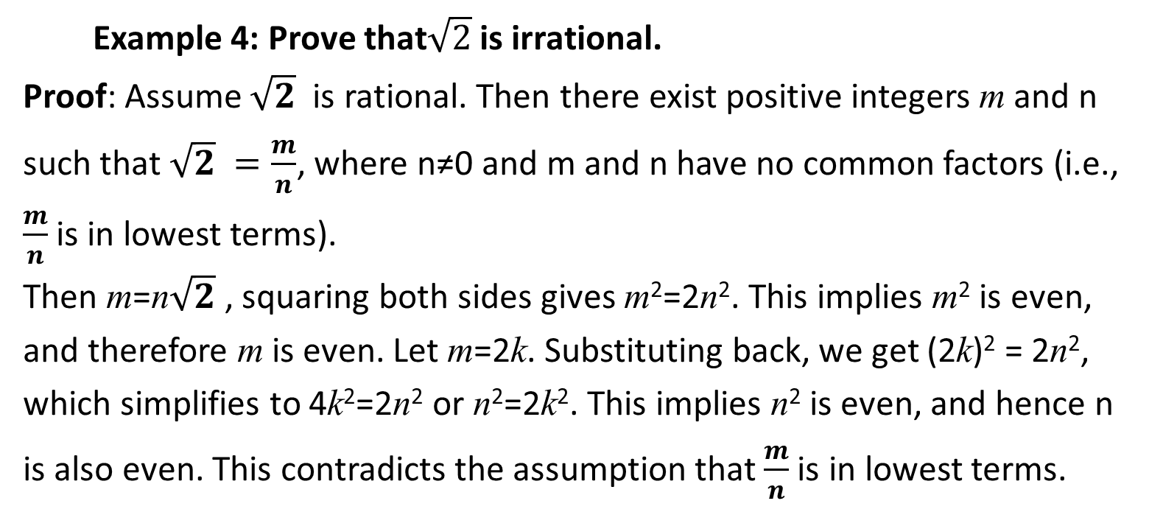
1.3 Proof Methods
⤷Indirect Proof Method • Proof by Contradiction(e.g)
Example 4: Prove that$\sqrt{2}$ is irrational.
Proof: Assume $\sqrt{2}$ ​ is rational. Then there exist positive integers m and n such that $\sqrt{2} =\frac{m}{n}$, where n≠0 and m and n have no common factors (i.e., $\frac{m}{n}$​ is in lowest terms).
Then m=n$\sqrt{2}$ ​, squaring both sides gives m²=2n². This implies m² is even, and therefore m is even. Let m=2k. Substituting back, we get (2k)² = 2n², which simplifies to 4k²=2n² or n²=2k². This implies n² is even, and hence n is also even. This contradicts the assumption that $\frac{m}{n}$​ is in lowest terms.
Proof by Contradiction is a special form of indirect proof: by showing that the negation of the conclusion leads to the negation of the premise, thereby contradicting the initial assumption.
Notes:
事实：每个有理数都可以写成既约分数
例4 证明命题： 是无理数
证 假设 是有理数, 存在正整数n,m, 使得 =m/n, 其中n ≠0且n,m没有公因子（m/n为既约分数）。
于是m=n , m²=2n², m²是偶数,
从而m是偶数. 设m=2k, 得 (2k)²=2n², n²=2k², 这又得到n也是偶数, 与m/n为既约分数矛盾.
间接证明法是归谬法的特殊形式: 由B不成立推出A不成立, 与前提A成立矛盾.

Slide 32
1.3 Proof Methods
⤷Indirect Proof Method • Proof by Exhaustive
Definition: Exhaustive method (also known as the method of exhaustion) is a technique used to prove a proposition by verifying all possible cases. This method is typically applied when the number of possible situations is finite and can be explicitly listed.
Scope of application: It is suitable for problems where the solution space is small and manageable.
Proof process: The prover needs to examine each possible case one by one and demonstrate that the proposition holds true in all these situations.
Characteristics: The key to the exhaustive method lies in its completeness, ensuring that all possible cases are considered. However, it is generally impractical when dealing with a large solution space.
Notes:
穷举法：通过列举所有可能的情况并验证每一种情况，来证明一个命题。它适用于可能情况数量有限的场景
定义：穷举法（穷尽法），是一种通过检验所有可能的情况来证明命题的方法。这种方法通常用于问题的可能情况数量有限并且可以明确列出的情况。
使用场景：它适用于问题的解空间小且可管理的情况。
证明过程：证明者需要一一检验每种可能的情况，并证明在这些情况下命题都是成立的。
特点：穷举法的关键在于完全性，即确保所有可能的情况都被考虑到。但它在解空间大时通常不可行。

Slide 33
1.3 Proof Methods
⤷Indirect Proof Method • Proof by cases
Definition: Proof by cases is a method where the original problem is decomposed into several smaller, more manageable sub-problems, each of which is proven individually. The sum of these sub-problems covers all situations of the original problem.
Usage Scenario: It is applicable when the problem inherently possesses natural classifications or when the solution can be simplified through logical division.
Proof Process: The prover decomposes the problem into several non-overlapping cases based on different characteristics or conditions and proves the correctness of the proposition for each case individually.
Characteristics: The focus of proof by cases lies in the effective division of the problem and the independent handling of each sub-case. This method may employ different proof strategies in different situations.
Notes:
定义：分情况证明法是将原问题分解成若干个更小的、更易于管理的子问题，并对每个子问题分别进行证明的方法。这些子问题的总和涵盖了原问题的所有情况。
使用场景：它适用于问题本身具有自然的分类，或者可以通过逻辑上的划分来简化问题的解决。
证明过程：证明者根据问题的不同特征或条件将其分解成若干个互不相交的情况，对每种情况分别证明命题的正确性。
特点：分情况证明法的重点在于对问题的有效划分和每个子情况的独立处理。这种方法在不同的情况下可能有不同的证明策略。

Slide 34
1.3 Proof Methods
⤷Indirect Proof Method • Proof by cases(e.g)
Definition: The proposition to be proven is of the form = A₁∨A₂∨…∨A_{k} →B.
Method: Prove that A₁→B, A₂→B,…, A_{k}→B are all true.
Example 5: Prove that max⁡(a,max⁡(b,c))=max⁡(max⁡(a,b),c). Proof:
情况 | u=max(b,c) | max(a,u) | v=max(a,b) | max(v,c)
a ≤ b ≤ c | c | c | b | c
a ≤ c ≤ b | b | b | b | b
b ≤ a ≤ c | c | c | a | c
b ≤ c ≤ a | c | a | a | a
c ≤ a ≤ b | b | b | b | b
c ≤ b ≤ a | b | a | a | a
Notes:
穷举法：通过列举所有可能的情况并验证每一种情况，来证明一个命题。它适用于可能情况数量有限的场景
待证明的命题形式为A= A₁∨A₂∨…∨A_{k} →B.
做法 分别证明A₁→B, A₂→B,…, A_{k}→B 均为真
例5 证明:max(a, max(b,c))=max(max(a,b),c)
证：

Slide 35
1.3 Proof Methods
⤷Constructive Proof Method
Definition: A proof by construction involves creating a specific example or object to prove the truth of a proposition. This method is typically used for "existence proofs."
Method: Under the condition that A is true, construct an object with this property.
Example 6: For every positive integer n, there exist n consecutive positive composite numbers.
Proof: Let x=(n+1)!. Then x+2,x+3,…,x+n+1 are n consecutive positive composite numbers:
For i=2,3,…,n+1, x+i is composite.
Notes:
因为 i 是 2 到 n+1 之间的整数，所以 i 必然是 (n+1)! 的一个因子（因为 (n+1)! 是所有小于等于n+1 的正整数的乘积）。 这意味着每个数 (n+1)!+i 都可以被 k 整除，所以这些数都不是质数。
这个构造证明法的关键在于使用阶乘 (n+1)! 作为基础，并在此基础上加上连续的整数，确保每个生成的数都不是质数，从而都是合数。通过这种方法，我们不仅证明了这些数是合数，而且证明了它们是连续的。
构造证明法通过构造一个特定的例子或对象，来证明某个命题的真实性。这种方法通常用于“存在性证明”.
做法 在A为真的条件下, 构造出具有这种性质的客体
例6 对于每个正整数n, 存在n个连续的正合数.
证 令x=(n+1)!
则 x+2, x+3,…, x+n+1是n个连续的正合数:
i | x+i, i=2,3,…,n+1

Slide 36
1.3 Proof Methods
⤷Non-Constructive Proof Method
Constructive Proof: A constructive proof provides one or more specific instances or examples to prove a proposition. It is applicable when demonstrating that there exist particular objects or numbers that satisfy certain conditions.
Non-Constructive Proof: A non-constructive proof establishes the truth of a proposition without directly presenting specific examples. This method often relies on logical reasoning, existing theories, or theorems, or employs techniques such as proof by contradiction.
When it is difficult to directly construct an instance that meets the required conditions, non-constructive proofs allow us to prove the existence of certain entities or the truth of certain propositions.
Notes:
x要么是素数，要么是合数。如果x是素数，那么它大于 p，与我们的假设（p 是最大的素数）矛盾。
构造性证明：提供一个或多个具体的实例或例子来证明命题。它适用于展示存在满足特定条件的具体对象或数值。
非构造性证明：证明命题的真实性而不直接展示具体的例子。这种方法通常依赖于逻辑推理、现有理论或定理，或使用反证法等技巧。
直接构造一个满足条件的实例困难时，非构造性证明允许我们证明某些事物的存在或某些命题的真实性。

Slide 37
1.3 Proof Methods
⤷Vacuous Proof Method (Proof by Vacuity)
A vacuous proof is commonly used to prove statements of the form "All objects satisfying a particular property P also satisfy another property Q" (P→Q). This method is particularly applicable when no objects satisfy the initial property P. In such cases, the statement is considered true because there are no counterexamples to invalidate it.
A conditional statement P→Q is false only when P is true, and Q is false. Therefore, to prove P→Q is always true using the vacuous proof method, it suffices to show that P is always false.
Example: Let n ∈ N. Define P(n): If n > 1, then n² > 1. Prove that P(0) is true. P(0): If 0 > 1, then 0² > 1. Since the premise 0 > 1 is always false, by the vacuous proof method, we can assert that P(0) is true.
Notes:
空证明法(前件假证明法)
空证明法通常用于证明“所有满足某特定性质的对象都具有另一种性质”的命题(P→Q)。当没有任何对象满足第一种性质时，这样的命题被认为是真的，因为不存在违反该命题的例子。
当且仅当 P 为真而 Q 为假时，蕴含式 P→Q为假的，空证明法只需证明P恒为假，从而得出P→Q为恒为真的结论。
例 设n∈N，记P(n): 若n>1，则n²>1. 试证明P(0)为真．
P(0): 若0>1，则0²>1.
由于P(0)前提条件 0>1 永远不成立，根据空证明法，我们可以说 P(0) 是真的。

Slide 38
1.3 Proof Methods
⤷ Trivial Proof Method
Trivial Proof Method (Proof by Showing the Consequent is True)
The trivial proof method is used to prove propositions that are clearly true under specific conditions.
Method: Prove that B is always true, without needing to assume A is true.
Example: If a≤b, then a⁰≤b⁰.
Proof: Based on a universally accepted mathematical fact, any number raised to the power of 0 equals 1. Therefore, regardless of the size relationship between a and b, both a⁰ and a⁰≤b⁰ equal 1. Hence, a⁰≤b⁰holds.
This method often appears in the base case of induction proofs.
Notes:
平凡证明法(后件真证明法)
平凡证明法证明某些在特定条件下显然成立的命题
做法 证明B恒为真, 而不需要假设A为真.
例： 若a≤b, 则a⁰≤b⁰. a to the zeroth power
证：
基于一个普遍接受的数学事实，即任何数的0次方等于1。则无论a，b的大小关系，都有a⁰=b⁰ =1， a⁰≤b⁰都成立。
常在归纳证明的归纳基础中出现

Slide 39
1.3 Proof Methods
⤷ Induction and Conjecture
Induction is a logical reasoning method that starts from specific cases or instances and generalizes to universal laws or principles. A conjecture is an unproven hypothesis or theory proposed based on existing knowledge and intuition.
Induction and conjecture often interact in the research process. Induction may lead to the formation of new conjectures, while conjectures can potentially gain support through induction from experimental or observational data.
For example, observation
1=1²
1+3=2²
1+3+5=3²
1+3+5+7=4²
… …
Conjecture: The sum of the first n odd numbers equals n²,
1+3+5+ … +(2n-1)=n²
Notes:
Inductive Reasoning and Conjecture 归纳法是一种从具体案例或实例出发，提炼出一般性规律或原理的逻辑推理方法。猜想是一种基于现有知识和直觉提出的未经证实的假设或理论。归纳法和猜想在研究过程中经常相互作用。归纳法可能导致新的猜想的形成，而猜想又可能通过归纳法从实验或观察数据中获得支持。
猜想: 前n个奇数之和等于n², 即
1+3+5+ … +(2n-1)=n²

Slide 40
1.3 Proof Methods
⤷ Induction Proof Method
Proposition form: ∀x(x∈N∧x≥n₀), P(x)
Base case: Prove P(n₀) is true
Inductive step: For all x(x≥n₀), assume P(x) is true, prove P(x+1) is true. The statement "P(x) is true" is called the induction hypothesis.
Example 8: Proof: For all n≥1, 1+3+5+…+(2n-1)=n² Proof:
Base case: When n=1, 1=1², the conclusion holds. Inductive step: Assume the conclusion holds for n≥1, then 1+3+5+…+(2n-1)+(2n+1)=n² +(2n+1) = (n+1)² Thus, the conclusion also holds when n+1.
Notes:
1)归纳基础 证P(n₀)为真
(2)归纳步骤 ∀x(x≥n₀), 假设P(x)为真, 证P(x+1)为真.
称“P(x)为真”为归纳假设
例8 证明:对所有n≥1, 1+3+5+ … +(2n-1)=n²
证 归纳基础. 当n=1时, 1=1², 结论成立.
归纳步骤. 假设对n≥1结论成立, 则有
1+3+5+ … +(2n-1)+(2n+1)=n² +(2n+1) = (n+1)²
得证当n+1时结论也成立.

Slide 41
1.3 Proof Methods
⤷ Induction Proof Method (e.g)
Note: Both the base case and the inductive step are essential.
Example(1) Proposition: For all n≥1, 2¹+2²+ … + 2^{n}= 2^{n+1} – 2
Proof:
Base case: When n=1, 2¹ = 2¹⁺¹ – 2=2.
Inductive hypothesis: Assume the statement holds for some arbitrary n≥1. Then, 2¹+2²+ … + 2^{n}+2^{n+1}= 2^{n+1}+2^{n+1} -2= 2^{n+2} - 2.
Thus, the proposition holds for n+1.
Notes:
注意: 归纳基础与归纳步骤两者缺一不可
例1 命题 ∀n≥1, 2¹+2²+ … + 2^{n}= 2^{n+1} – 2
归纳基础：n=1时， 2¹ = 2¹⁺¹ – 2=2
归纳假设：∀n≥1, 结论成立, 则
2¹+2²+ … + 2^{n}+2^{n+1}= 2^{n+1}+2^{n+1} = 2^{n+2} - 2
命题对n+1结论成立.

Slide 42
1.3 Proof Methods
⤷ Proof by Counterexample
The method of counterexamples involves finding one or more examples to refute a universal statement. This method is typically used to prove that a proposition is incorrect.
Example(2): Observe whether 2^{n-1}-1 is divisible by n.
n | 2^{n-1}-1 | divisible | N | 2^{n-1}-1 | divisible
3 | 3 | Y | 10 | 511 | N
4 | 7 | N | 11 | 1023 | Y
5 | 15 | Y | 12 | 2047 | N
6 | 31 | N | 13 | 4095 | Y
7 | 63 | Y | 14 | 8191 | N
8 | 127 | N | 15 | 16383 | N
9 | 255 | N | 16 | 32767 | N
Notes:
举反例法通过找到一个或多个例子来反驳一个普遍性的命题。这种方法通常用于证明某个命题是错误的。
例2 观察2^{n-1}-1 是否被n整除

Slide 43
1.3 Proof Methods
⤷ Proof by Counterexample
n | 2^{n-1}-1 | 整除 | n | 2^{n-1}-1 | 整除
17 | 65535 | Y | 21 | 1048575 | N
18 | 131071 | N | 22 | 2097151 | N
19 | 262143 | Y | 23 | 4194303 | Y
20 | 524287 | N | 24 | 8388607 | N
From the table, we might induce the following proposition:
Let n≥3. A necessary and sufficient condition for n to be a prime number is that 2^{n−1}−1 is divisible by n. However, this proposition is not true.
Counterexample: 561=3×11×17 is a composite number, yet 2560−1 is divisible by 561.
Notes:
由上表可能会归纳出下述命题
命题 设n≥3, n是素数的充分必要条件是2^{n-1}-1被n整除.
但此命题不真.
反例： 561=3×11×17是合数, 而2⁵⁶⁰-1能被561整除.

Slide 44
1.3 Proof Methods
⤷ Complete Induction
Complete Induction (also known as Strong Induction) is a proof technique used to establish the truth of a statement for all integers greater than or equal to a certain number. It is an extension of the principle of mathematical induction, where, instead of assuming the truth of the statement only for the immediate predecessor (i.e., P(k)), it assumes the truth of the statement for all values from the base case up to k.
Base Case: Prove that P(n₀) is true.
Inductive Step: For all x (where x≥ n₀), assume P(n₀),P(n₀ +1),…,P(x) are true, and prove that P(x+1) is true.
Inductive Hypothesis: For all y (where n₀ ≤y≤x), P(y) is true.
Notes:
归纳基础 证明P(n₀)为真
归纳步骤 ∀x(x≥n₀), 假设P(n₀),P(n₀+1),…,P(x)为真,
证P(x+1)为真.
归纳假设 ∀y(n₀≤y≤x), P(y)为真
例9 任何大于等于2的整数均可表成素数的乘积
证：
归纳基础. 对于2, 结论显然成立.
归纳步骤. 假设对所有的k(2≤k≤n)结论成立, 要证结论
对n+1也成立. 若n+1是素数, 则结论成立; 否则n+1=ab,
2≤a,b<n. 由归纳假设, a,b均可表成素数的乘积, 从而n+1
也可表成素数的乘积. 得证结论对n+1成立.

Slide 45
1.3 Proof Methods
⤷ Complete Induction(e.g)
Example 9: Every integer greater than or equal to 2 can be expressed as a product of prime numbers. Proof:
Base Case: For n=2, the statement is obviously true.
Inductive Step: Assume that for all integers k such that 2≤k≤n, the statement holds true. We need to show that the statement also holds for n+1.
If n+1 is a prime number, then the statement is true.
If n+1 is not a prime number, then it can be expressed as n+1=a×b, where 2≤a,b<n.
By the inductive hypothesis, both a and b can be expressed as products of prime numbers. Therefore, n+1 can also be expressed as a product of prime numbers. Thus, the statement holds for n+1.
The base case of strong induction does not merely assume that the proposition holds for a specific natural number n; instead, it assumes that the proposition holds for all natural numbers less than or equal to n. Based on this stronger assumption, we then prove that the proposition holds for n + 1.
Notes:
归纳基础 证明P(n₀)为真
归纳步骤 ∀x(x≥n₀), 假设P(n₀),P(n₀+1),…,P(x)为真,
证P(x+1)为真.
归纳假设 ∀y(n₀≤y≤x), P(y)为真
例9 任何大于等于2的整数均可表成素数的乘积
证：
归纳基础. 对于2, 结论显然成立.
归纳步骤. 假设对所有的k(2≤k≤n)结论成立, 要证结论
对n+1也成立. 若n+1是素数, 则结论成立; 否则n+1=ab,
2≤a,b<n. 由归纳假设, a,b均可表成素数的乘积, 从而n+1
也可表成素数的乘积. 得证结论对n+1成立.

Slide 46
1.3 Proof Methods
⤷ Complete Induction(e.g)
Example 10: Any postal fee of n cents (where n≥12) can be composed using 4-cent and 5-cent stamps. Proof:
Base Case: For n=12,13,14,15, the following combinations are possible:
12=3×4,
13=2×4+5,
14=2×5+4,
15=3×5. Thus, the conclusion holds for n=12,13,14,15.
Inductive Step: Let n≥15, and assume that the conclusion holds for all integers from 12 to n.
Consider n+1. Since n−3≥12 and by the inductive hypothesis, n−3 cents can be composed using 4-cent and 5-cent stamps.
By adding one 4-cent stamp to the composition of n−3 cents, we obtain n+1 cents.
Therefore, the conclusion holds for n+1.
The base case of strong induction does not merely assume that the proposition holds for a specific natural number n; instead, it assumes that the proposition holds for all natural numbers less than or equal to n. Based on this stronger assumption, we then prove that the proposition holds for n + 1.
Notes:
归纳基础 证明P(n₀)为真
归纳步骤 ∀x(x≥n₀), 假设P(n₀),P(n₀+1),…,P(x)为真,
证P(x+1)为真.
归纳假设 ∀y(n₀≤y≤x), P(y)为真
例9 任何大于等于2的整数均可表成素数的乘积
证：
归纳基础. 对于2, 结论显然成立.
归纳步骤. 假设对所有的k(2≤k≤n)结论成立, 要证结论
对n+1也成立. 若n+1是素数, 则结论成立; 否则n+1=ab,
2≤a,b<n. 由归纳假设, a,b均可表成素数的乘积, 从而n+1
也可表成素数的乘积. 得证结论对n+1成立.

Slide 47
1.3 Proof Methods
⤷ Proof by Counterexample
The Proof by Counterexample is a logical proof technique used to demonstrate that a general statement or conjecture is false by providing a specific example that contradicts the statement
Example 11: Prove that the following statement does not hold:
If A∩B = A∩C , then B = C.
Proof:
Counterexample: Let A={a,b}, B={a,b,c}, and C={a,b,d}.
Then, A∩B={a,b}, A∩C={a,b}. Thus, A∩B=A∩C.
However, B≠C because c∉C and d∉B.
Therefore, the statement does not hold
Notes:
例11 证明下述命题不成立:
若A∩B=A∩C, 则B=C.
证明 反例: 取A={a,b}, B={a,b,c}, C={a,b,d}, 有
A∩B=A∩C = {a,b}
但B≠C, 故命题不成立.

Slide 48
1.4 Recursive Definition (Inductive Definition)
Recursive Definition is a process where a concept is defined in terms of itself.
Example: The sequence an can be recursively defined as follows:
a⁰=1, a^{n}= a^{n−1}⋅a, for n=1,2,…
Example 12: The Fibonacci sequence {f_{n}} is recursively defined as follows:
f₀=1, f₁=1, f_{n}=f_{n-1}+ f_{n-2}, for n=2,3,…Calculating the first few terms:
f₀=1, f₁=1, f₂=2, f₃=3, f₄=5, f₅=8, f₆=13
Notes:
递归定义(归纳定义) 用自身定义自身的过程
例如, a^{n}可以递归定义如下:
a⁰=1
a^{n}= a^{n-1}⋅a, n=1,2,…
例1.12 菲波那契数列{f_{n}}递归定义如下:
f₀=1, f₁=1
f_{n}= f_{n-1}+ f_{n-2}, n=2,3,…
f₀=1, f₁=1, f₂=2, f₃=3, f₄=5, f₅=8, f₆=13, ….

Slide 49
1.4 Recursive Definition
⤷ A recursive definition of a set
Example 13: The set A is recursively defined as follows:
Base Step: 3 ∈A
Recursive Step(Rule ):
(1) If x, y ∈A , then x + y ∈A .
(2) All numbers obtained by applying the recursive step a finite number of times belong to the set A.
A={3n | n∈Z⁺}
Notes:
例1.13 集合A的递归定义如下:
(1) 基础步骤： 3∈A,
(2) 递归步骤：若x, y∈A, 则x+y∈A,
有限次使用 (2)得到的数属于集合A.
A={3n | n∈Z⁺}

Slide 50
1.4 Recursive Definition
⤷ Recursive definition of arithmetic expression
In 2024, Meituan Delivery was the most popular online food delivery app in China, boasting approximately 83 million monthly active users and a 22.4% increase in revenue compared to the previous year. The growing popularity of food delivery has been driven by several factors, including the widespread adoption of smartphones, the increasing use of mobile apps, and advancements in online platform algorithms.
Example 14: Arithmetic expressions are defined inductively as follows:
(1) Any real number and variable is an arithmetic expression.
(2) If f and g are arithmetic expressions, then (f + g), (f−g), and (f×g) are also arithmetic expressions.
(3) If f and g are arithmetic expressions and g≠0, then (f/g) is an arithmetic expression.
(4) If f is an arithmetic expression, then for all n∈Z⁺, f ^{n} (or f↑n) is an arithmetic expression.
(5) Only those expressions obtained by a finite number of applications of rules (1) through (4) are considered arithmetic expressions.
Notes:
例1.14 算术表达式的归纳定义如下:
(1) 任何实数和变量都是算术表达式,
(2) 如果f, g是算术表达式, 则(f+g), (f-g), (f∗g)是算术表达式,
(3) 如果f, g是算术表达式且g≠0, 则(f/g)是算术表达式,
(4) 如果f是算术表达式, 则∀n∈Z⁺, (f↑n)是算术表达式,
(5) 只有有限次使用(1)~(4)得到的式子是算术表达式.
f↑n 表示函数 fff 的迭代应用，即将函数 fff 应用 nnn 次。
如, ((3∗x)-1), (((2∗(x↑2))+(5∗x))-4), (((x+y)-z)/(5+x)) The notation x↑2x\uparrow 2x↑2 is typically used in the context of Knuth's up-arrow notation. In this case, x↑2x \uparrow 2x↑2 means exponentiation, or x2x^2x2.

Slide 51
Chapter 1: Set Theory and Proof Methods • Brief summary
Objective :
Key Concepts ：

